Slide 1

Case Study “Analysis of Super Store”
Name – Shashank Sinha
SkillBuild Id – shivamsinha66@gmail.com
College – Vishwavidyalaya Engineering College, Ambikapur
College State – Chhattisgarh
Domain – Data Analytics(DA)
From 09/06/2023 to 24/07/2023

Slide 2



Case Study “Analysis of Super Store”
PROJECT TOPIC

Slide 3

AGENDA :-
Agenda is to work on a Super store dataset and perform a comprehensive analysis to extract valuable insights from the available features.
The insights gained from this analysis will play a crucial role in helping the organization improve its business operations and boost profitability.
The chosen dataset is considered an ideal real-life dataset, making it a practical opportunity to apply the knowledge acquired from the data analytics internship conducted by IBM.

Slide 4

Project Overview :-
Purpose:
Analyze Super store dataset to improve business operations and profitability.
Scope:
Analyzing a specific Super store dataset.
Exploring features for patterns, trends, and relationships.
Data cleaning and preprocessing.
Objective:
Gain insights for optimizing organization's operations and customer behavior.
Apply skills learned from IBM Data Analytics Internship.
Improve business practices and drive profitability.
By achieving these objectives, this project will contribute to the organization's growth and success.

Slide 5

Who are the end users ?
Target Audience/End Users:
Organization Management
Sales and Marketing Team
Operation and Supply Chain Team
Customer Service Team
Data Analysists and Data Scientists
By providing these target audiences with valuable insights, they can make informed decisions, optimize business strategies, enhance operational efficiency, improve customer satisfaction, and ultimately drive the organization's success.

Slide 6


Solution And its Value Proposition :-
Our solution utilizes the Super store dataset to provide actionable insights that address the needs of end users:
Organization Management: Data-driven decisions, optimized business operations, increased profitability.
Sales and Marketing Teams: Targeted strategies, improved customer engagement, enhanced sales performance.
Operations and Supply Chain Teams: Optimized inventory management, streamlined logistics, cost reduction.
Customer Service Teams: Enhanced customer satisfaction, improved issue resolution.
Data Analysts and Data Scientists: Practical experience, applied analytical techniques, meaningful insights.
Our solution brings value by enabling informed decision-making, optimizing strategies, enhancing efficiency, and driving business success.

Slide 7

Customizing and making it own :-
Unique Aspects/Features of Our Solution:
Innovative Data Analysis Techniques
Real-Life Dataset for Practical Experience
Comprehensive Scope of Analysis
Actionable Insights for Decision-Making
Customized Recommendations for End Users
Our solution stands out with its innovative techniques, real-life dataset, comprehensive analysis, actionable insights, and customized recommendations.

Slide 8

Modelling :-
Techniques, Methodologies, and Frameworks Applied:
Exploratory Data Analysis (EDA)
Data Cleaning and Preprocessing
Statistical Analysis
Machine Learning Algorithms
Visualization Techniques
We utilized EDA, data cleaning, statistical analysis, machine learning algorithms, and visualization techniques in our analysis. These approaches enabled us to gain insights, validate findings, and effectively communicate results. We followed a structured process based on industry-standard frameworks such as CRISP-DM.

Slide 9

Result :-
We are at the end of the project. We have downloaded the dataset, explored it, cleaned it and analyzed it at every possible way. In between all these we have encountered some awesome facts about the data. So, after this exploratory analysis we can conclude our observations and insights in some simple points as follows.
Large cities, like New York, Los Angeles, Seatle, San Francisco are generating highest amount of Sales as well as Profit.
In case of Categories, Technology is always leading in terms of Sales and Profit.
Some cities are there, where company is giving huge discounts but very less sales and profit is generating.
Also there are cities, where discounts are totaly '0', but they are generating high profits.
Maximum corporates as well as consumers prefer the Standard class of ship-mode.
There are cities where sales as well as profit is very low, infact company is going with a loss there.
Above insights are just few such key points where the organization should focus more to enhance their business and reduce the loss as much as possible. Company campaigns can be well directed with help of these key notes. Hopefully the whole analysis will help the company to grow in upcoming days. That's all.

Slide 10

Links :-
https://www.kaggle.com/datasets/vivek468/superstore-dataset-final
https://anaconda.org/anaconda/anaconda-navigator/files?sort=ndownloads&sort_order=desc
https://www.python.org/downloads/

Slide 11
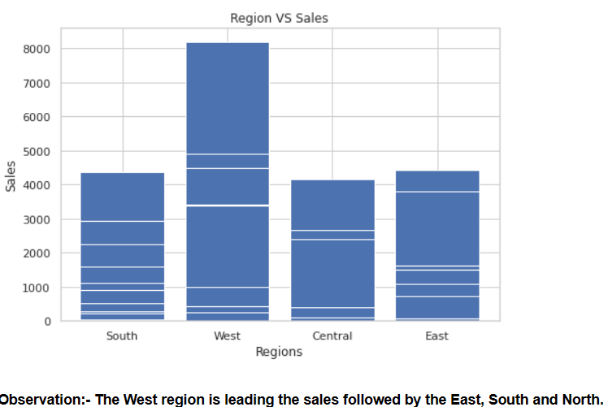
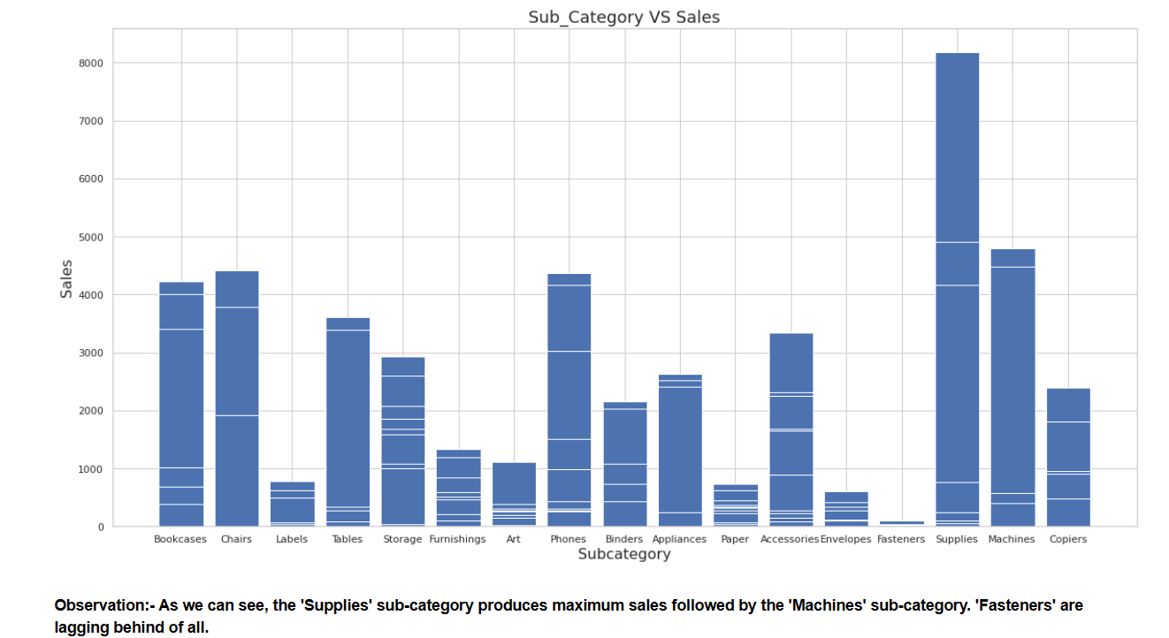
Additional Slides

Slide 12
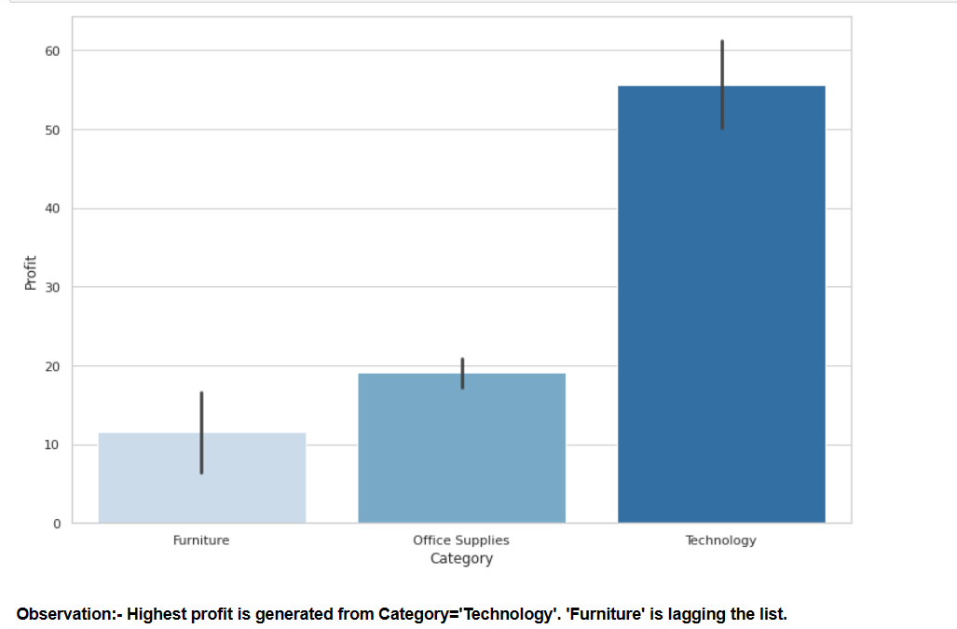

Slide 13
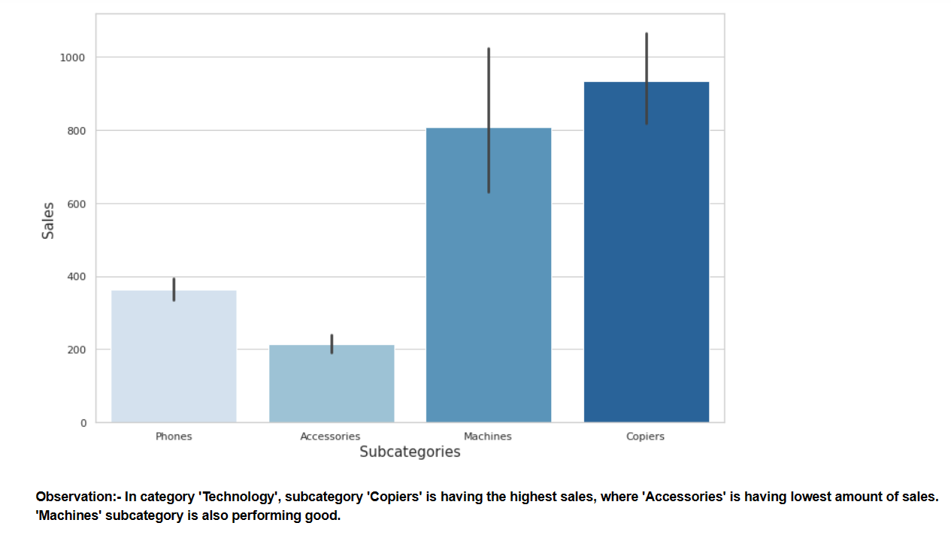

Slide 14
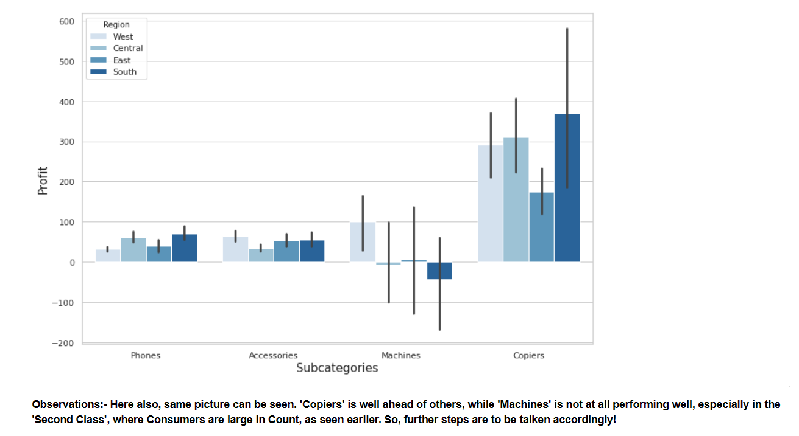

Slide 15
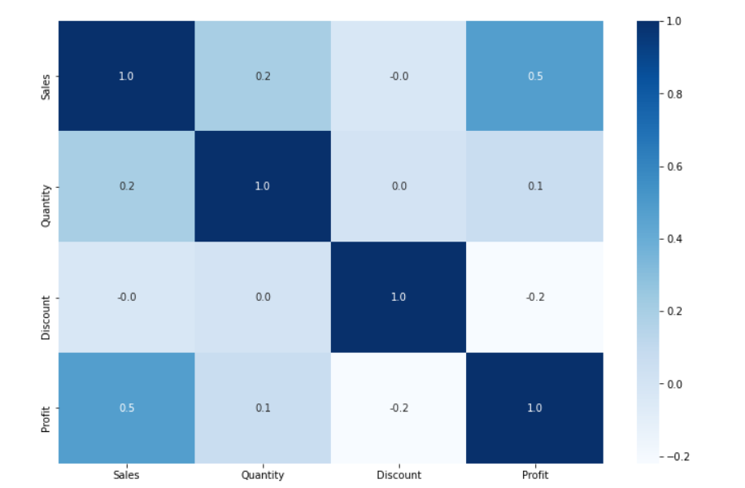
Co relation graph

Slide 16
Thank You!

